Slide 1
LINQ
11-Apr-18 | Start
Appendix
Online

Slide 2
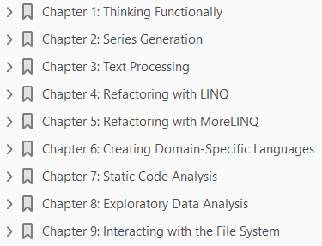
LINQ
Ch | Date
1 | ddmmmyy
2
3
4
5
6
7
8
Thinking in LINQ 2014

Slide 3
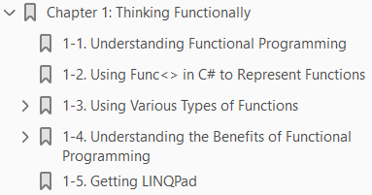
1
Thinking Functionally

Slide 4
Intro
As you begin this book, I urge you to forget everything you know about programming and bear with me while I walk you through a high-level view of what I think programming is.
To me, to program is to transform. I’ll give you a few simple examples to explain my viewpoint.
First, suppose you have some data in a database and you want to show some values in a website after performing some calculations on that data.
What are you actually doing here? You are transforming the data.
That first example is obvious, but there are many other less obvious examples.
Spell-checking, for example, is a transformation of a list of dictionary words to a set of plausible spelling-correction suggestions.
Generating a series of numbers that follow a pattern (such as the Fibonacci series) is also a transforming operation, in which you transform the initial two values to a series.

Slide 5
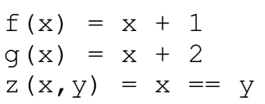
Understanding Functional Programming
Transforming data often requires intermediate transformations.
You can model each such intermediate transformation by a function.
The art of gluing together several such functions to achieve a bigger transformation is called functional programming.
Note that functional programming is nothing new. It’s just high-school math in disguise.
For example, suppose you have the following functions:
Using these functions, you can create several composite functions in which the arguments are functions themselves. For example, f.g (read as f of g) is shown as follows:

Slide 6
Understanding Functional Programming |
Similarly g.f (read as g of f) is as follows:
I will leave it up to you to determine that z(f.g) is equal to z(g.f) for all values of x. Now, imagine that your goal is to add 6 to x using these two functions.
Try to find the function call sequence that will do this for you. To think of it another way, functional programming is programming using functions but without worrying about the internal state of the variables.
Functional programming allows programmers to concentrate more on what gets done than how exactly how it gets done.
With that in mind, imagine that you want a cup of coffee. You go to the local coffee shop, but when you ask for coffee at the sales counter, you don’t worry in painful detail about how the coffee has to be made.
A great video by Dr. Don Syme, the man behind Microsoft’s functional programming language, F# explains this concept better than I ever could. I strongly recommend that you watch it (www.youtube.com/watch?v=ALr212cTpf4).

Slide 7
Using Func<> in C# to Represent Functions
You might be wondering how to port such functions to C#.
Fortunately, it’s quite straightforward. C# includes a class called Func.
Using this class, you can create functional methods much as you create variables of any primitive type, such as integers.
Here’s how you could write the functions described in the previous section:
Here’s how to define f.g (read f of g) by using Func<>:
In the preceding definition, fog is a function that takes two functions as arguments and calls them to obtain the final output.

Slide 8
Using Func<> in C# to Represent Functions |
The initial argument to the first function is provided in x.
Note how the function itself is passed as an argument to the composite function.
The Func<> class has several constructors that can be used to represent functions.
In each constructor, the last argument represents the return type.
So, for example, a declaration such as Func<int, int> represents a function that takes an integer and returns an integer.
Similarly, the function z (z(x, y) = x == y ) declared previously can be represented as Func<int, int, bool> because it takes two integers and returns a Boolean value.

Slide 9
Using Various Types of Functions
Several kinds of functions can be classified broadly into four major categories, as shown in Figure 1- 1:
Generator functions
Statistical functions
Projection functions
Filters

Slide 10
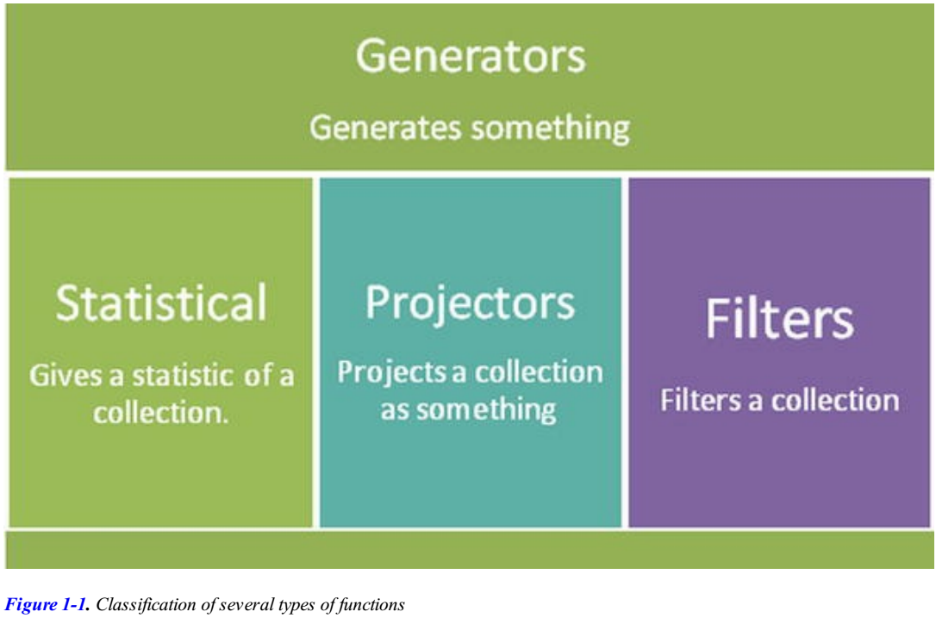
Figure 1-1

Slide 11

Generator Functions
A generator function creates values out of nothing.
Think of this as a method that takes no arguments but returns an IEnumerable<T>.
Enumerable.Range( ) and Enumerable.Repeat( ) are example of generator functions.
A generator function can be represented by the following equation, where T represents any type:

Slide 12

Statistical Functions
Statistical functions return some kind of statistic about a collection.
For example, you might want to know
how many elements are present in a collection, or
whether a given element is available in a collection
These types of operations are statistical in nature because they return either a number or a Boolean value.
Any( )
Count( )
Single( )
SingleOrDefault( )
are examples of statistical functions.
A statistical function can be represented by either of the following equations:

Slide 13
Projector Functions
Functions that take a collection of type T and return a collection of type U (where U could be the same type as T) are called projector functions.
For example, suppose you have a list of names, and the first and last names are separated by whitespace.
You want to project only the last names.
Because the full names are represented as strings, and the last name is a substring of the full name, it’s also a string.
Thus the result type of the projection is the same as that of the source collection (string).
So in this case, U is the same as T.
Here’s a situation where U and T don’t match: Say you have a list of integers, and each integer represents a number of days.
You want to create a DateTime array from these numbers by adding the day values to DateTime.Today.
In this case, the initial type is System.Int32, but the projection type is DateTime. In this case, U and T don’t match up.

Slide 14

Projector Functions |
Select( ), SelectMany( ), and Cast<T>( ) are other examples of projector functions.
A projector function can be represented by the following equation, where U can be the same as T:

Slide 15
Filters
Filters are just what you would think they are.
These functions filter out elements of a given collection that don’t match a given expression.
Where( )
First( )
Last( )
are examples of filter functions.
A filter function can be represented by either of the following equations:

Slide 16
Understanding Benefits of Functional Prog
I’ll walk you through the top five benefits of using a functional programming approach.
However don’t bother trying to memorize these.
After you get comfortable with functional programming, these will seem obvious.
The five top benefits are as follows:
Composability
Lazy evaluation
Immutability
Parallelizable
Declarative

Slide 17
Composability
Composability lets you create solutions for complex problems easily.
In fact, it’s the only good way to combat complexity.
Composability is based on the divide and rule principle.
Imagine you are planning a party and you want everything to be done properly.
You have a bunch of friends who are willing to help.
If you could give each friend a single responsibility, you could rest assured that everything would be done properly.
The same is true in programming.
If each method or loop has a single responsibility, each will be easier to refactor as new methods, resulting in cleaner and thus more maintainable code.
Functional programming thrives because of the composability it offers.

Slide 18
Lazy Evaluation
Lazy evaluation is a concept that provides the results of queries only when you need them.
Imagine that you have a long list of objects, and you want to filter that list based on a certain condition, showing only the first ten such matching entries in your user interface.
In imperative programming, each operation would be evaluated.
Therefore, if the filter operation takes a long time, your user would have to wait for it to complete.
However, functional programming languages, including implementations such as F# or LINQ, allow you to take advantage of deferred execution and lazy evaluation, in which the program performs operations such as this filter only when needed, thus saving time.
You’ll see more about lazy evaluation in Chapter 6.

Slide 19
Immutability
Immutability lets you write code that is free of side effects.
Although functional programming doesn’t guarantee that you will have code free of side effects, the best practices of functional programming preach this as a goal—with good reason.
Side effects such as shared variables not only may lead to ambiguous situations, but also can also be a serious hindrance in writing parallel programs.
Imagine you are in a queue to buy movie tickets.
You (and everyone else) have to wait until it’s your turn to buy a ticket, which prevents you from going directly into the theater.
Shared states or shared variables are like that.
When you have a lot of threads or tasks waiting for a single variable (or collection), you are limiting the speed with which code can execute.
A better strategy is more like buying tickets online.
You start your task or thread with its own token/variable/state. That way, it never has to wait for access to shared variables.

Slide 20
Parallelizable
Functional programs are easier to parallelize than their imperative counterparts because most functional programs are side-effect free (immutable) by design.
In LINQ, you can easily parallelize your code by using the
AsParallel( )
AsOrdered( )
operators
You’ll see a full example in Chapter 4.

Slide 21
Declarative
Declarative programming helps you write very expressive code, so that code readability improves.
Declarative programming often also lets you get more done with less code.
For example, it’s often possible to wrap an entire algorithm into a single line of C# by using LINQ operators.
You’ll see examples of this later in this book, in Chapters 6 and 8.

Slide 22
Getting LINQPad
You can enter and execute all the examples in this book with a useful tool called LINQPad.
LINQPad is a free C# / VB.NET / F# snippet compiler.
If you’re serious about .NET programming, you should become familiar with LINQPad—it does more than just let you test LINQ statements.
You can download LINQPad from http://www.linqpad.net/GetFile.aspx?LINQPad4Setup.exe.
I highly recommend you download and install LINQPad now, before you continue.
Some of the examples in this book run in LINQPad with the LINQPad language option set to C# Expressions.
The rest of the examples run in LINQPad with the LINQPad language option set to C# Statement(s).
I’ve made an effort to add reminders throughout the book where appropriate, but if you can’t get an example to run, check the LINQPad Language drop-down option.

Slide 23
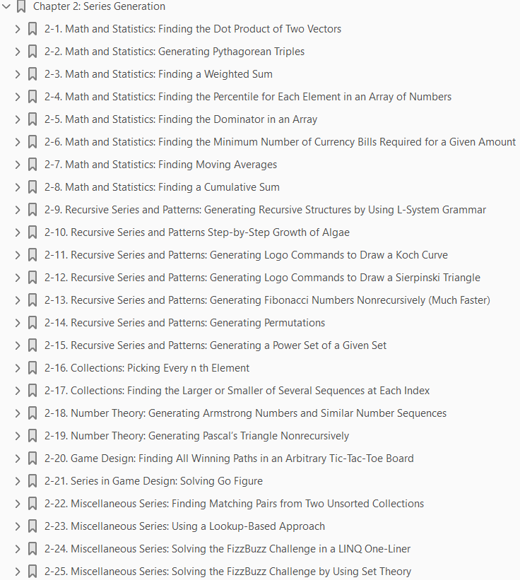
2
Series Generation

Slide 24
Intro
LINQ helps you generate series by using intuitive and readable code.
In this chapter, you will see how to use several LINQ standard query operators (LSQO) to generate common mathematical and recursive series.
All these queries are designed to run on LINQPad (www.linqpad.net) as C# statements.
Series generation has applications in many areas.
Although the problems in this chapter may seem disconnected, they demonstrate how to use LINQ to solve diverse sets of problems.
I have categorized the problems into six main areas:
Math and Statistics Recursive Series and Patterns
Collections Number Theory
Game Design Working with Miscellaneous Series
The following problems are related to simple everyday mathematics and statistics.

Slide 25

2-1
The dot product of two vectors is defined as the member-wise multiplication of their coefficients.
Problem - The problem is to write a function that finds the dot product of two vectors.
Solution - Use the Zip( ) standard query operator, passing it a function delegate that multiplies two values at the same location in the arrays.
Listing 2-1 generates the dot product of these two vectors.
Figure 2-1 shows the result.
How It Works - Zip( ) is a LINQ standard query operator that operates on two members at the same location (or index).
The delegate passed to Zip( ) denotes the function used to generate a zipped single value from the members at the same index in two series.
For a vector dot product, the function is a simple multiplication denoted by

Slide 26
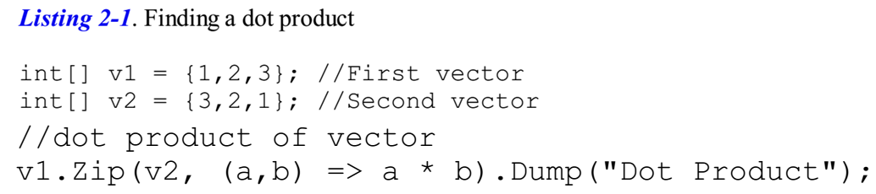
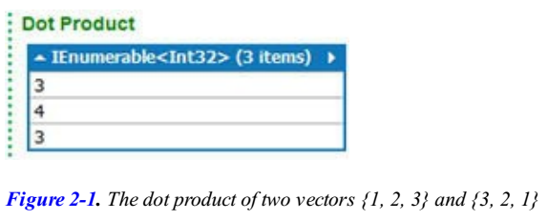
Listing 2-1 || Figure 2-1

Slide 27
2-2
A Pythagorean triple is a tuple of three integers that can form the sides of a right-triangle.
Problem: Use LINQ to generate a Pythagorean triple.
Solution: The most common Pythagorean triple is {3, 4, 5}.
The obvious scheme for generating more of these triples is to multiply an existing triple by some number.
For example, multiplying {3, 4, 5} by 2 yields {6, 8, 10}—another Pythagorean triple.
However, Babylonians came up with a more general formula for generating Pythagorean triples: The base and height assume the values of c * c –1 and 2 * c, respectively, where c represents a number greater than or equal to 2.
The hypotenuse, the longest side of a right triangle, is always one greater than the square of that number (c).
Listing 2-2 generates Pythagorean triplets by using the old and simple Babylonian formula.
This generates the output shown in Figure 2-2.

Slide 28
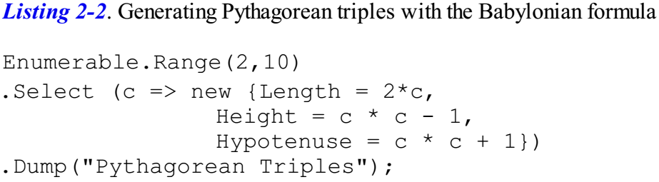
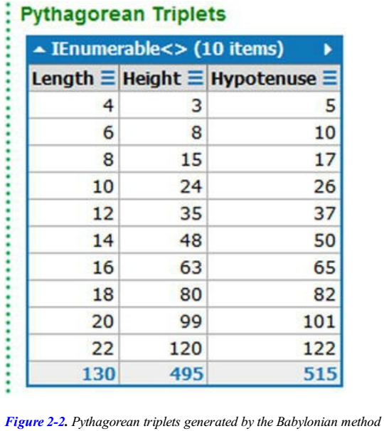
Listing 2-2 || Figure 2-2

Slide 29
How It Works
This example uses an anonymous type.
Note that the code doesn’t define a type with properties or fields named Length, Height, or Hypotenuse.
However, LINQ doesn’t complain. LINQPad clearly shows that the type of the projected collection is anonymous.
Check out the tool tip shown in Figure 2-3.
This feature is useful because it saves you from having to create placeholder classes or using tuples. (The example could have used a Tuple<int, int, int> in place of the anonymous method, but using the anonymous type improves readability.)
If, however, you project the result to a List<T> and then try to dereference it by using an index, you will see the properties Length, Height, and Hypotenuse as shown in Figure 2-4—just as if you had defined a strongly typed collection of some type with those public properties.

Slide 30
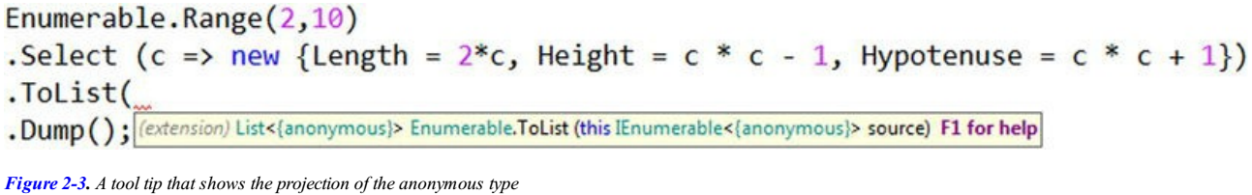
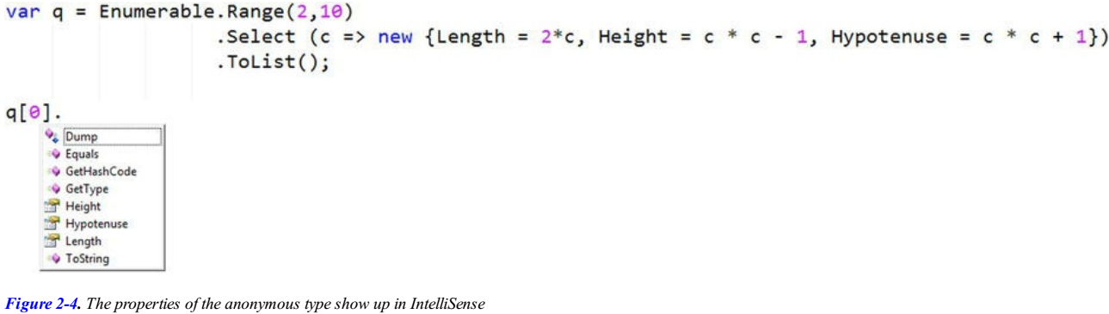
Figure 2-3 || 2-4

Slide 31
2-3

Slide 32
2-4

Slide 33
2-5

Slide 34
2-6

Slide 53
2-25

Slide 54
3
Text Processing

Slide 55
Intro
Text processing is a blanket term used to describe any kind of string processing.
Checking whether a pair of words are anagrams of each other is one example of text processing.
Generating suggestions for an autocomplete or assisted input process is another.
Some types of text processing, such as spellcheck and correction features, have become so commonplace that software users now expect them to be present in virtually every program they use.
LINQ changes the way developers deal with text because it lets you write intuitive code to solve complex text-processing tasks.
In this chapter, you will have a chance to solve some fun—yet useful —text-processing challenges.
The examples in this chapter vary widely in terms of difficulty. They are intended to serve as basic examples of how LINQ can help solve numerous text-processing problems.
The problems in this chapter fall into three broad but related categories:
Human-computer interactions that deal with various input strategies and spellcheck
Text generation and manipulation, such as the anagram problem mentioned earlier
Information extraction, such as pulling content from a document

